Slide 1
C Sharp
Arrays , Strings , Methods

Slide 2
Topics
Arrays
Declare , Initialize & Access
For Each Loop
Strings
Declare , Initialize and Access
Properties & Methods
Functions & Methods
Declare , Define and Invoke
Passing Arrays
Passing String
Recursive Functions
Variable Scope
Static/Global
Local/Automatic
Method’s Arguments
By Value
By Reference

Slide 3
Arrays

Slide 4
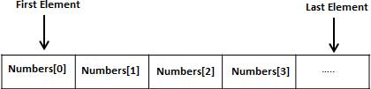
Arrays
Declaring Array
Syntax → datatype [] arrayName;
E.g → double[] balance;
Initializing an Array
double [] balance = new double[10];

Slide 5
Arrays
Accessing Arrays
Example 1:
double[] balance = new double[10];
balance[0] = 4500.0;
double[] balance = { 2340.0, 4523.69, 3421.0};
int [] marks = new int[] { 99, 98, 92, 97, 95};
int [] marks = new int[5] { 99, 98, 92, 97, 95};
int [] marks = new int[] { 99, 98, 92, 97, 95}; int[] score = marks;

Slide 6
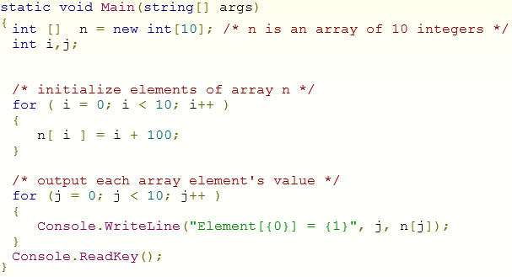
Example - Array

Slide 7
Problems - Arrays
Use Array to store N numbers and find their
Sum
Average
Product
Minimum Value
Maximum Value
Find Value ( Linear search)

Slide 8
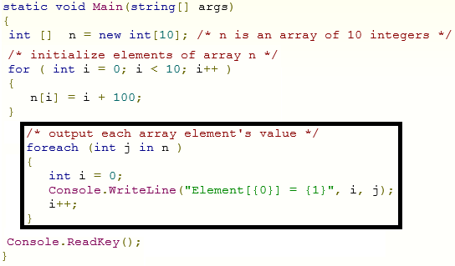
For Each - Loop

Slide 9
Strings

Slide 10
Strings
string name; // single variable
Alternate → char [] name = new char[30];
string [] names; // array of string – names

Slide 11
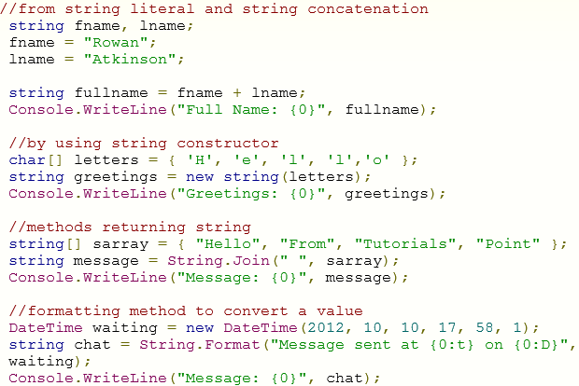
String – Declare, Define & Access

Slide 12
Strings
Properties
Chars
Length (Gets the number of characters in the current String object)
Important Methods
int Compare( string strA, string strB )
int Compare( string strA, string strB, bool ignoreCase )
string Concat( string str0, string str1 )
string Join( string separator, params string[] value )
bool Contains( string value )
bool IsNullOrEmpty( string value )
string ToLower() .. etc

Slide 13
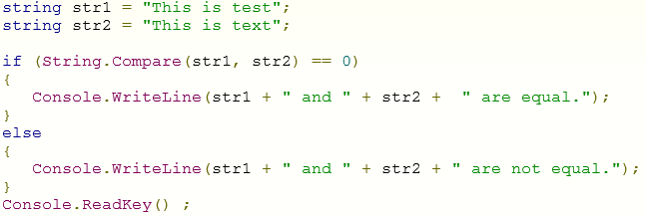
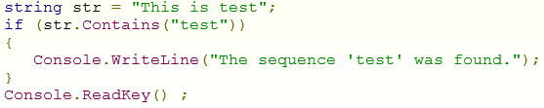
Example - String

Slide 14

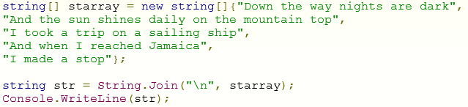
Example - String

Slide 15
Methods

Slide 16

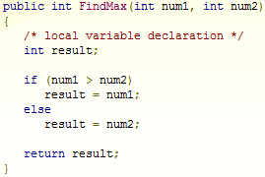
Functions & Methods

Slide 17
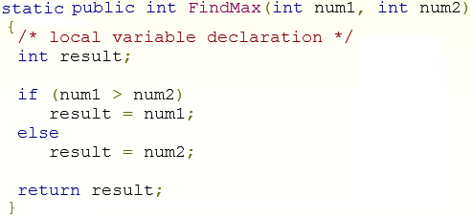
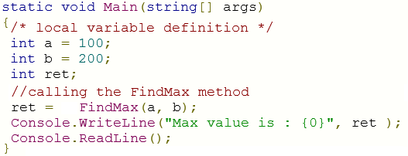
Example - Method

Slide 18
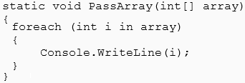
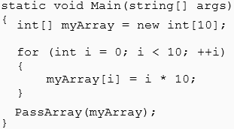
Example - Passing Arrays

Slide 19
Problems - Function
Use Array to store N numbers and find required values by Writing and invoking following functions
Sum
Average
Product
Minimum Value
Maximum Value
Find Value ( Linear search)

Slide 20
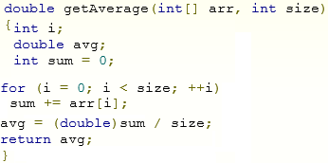
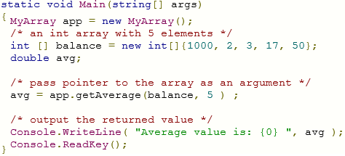
Passing Arrays

Slide 21
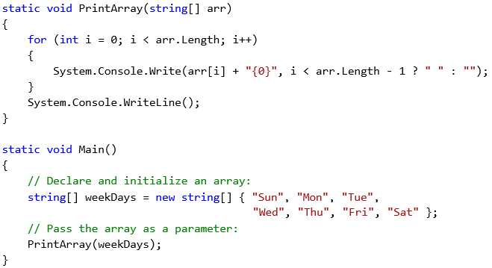
Passing String Arrays

Slide 22
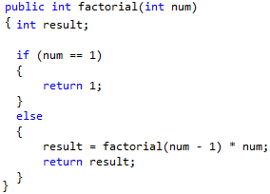
Recursion – with example

Slide 23
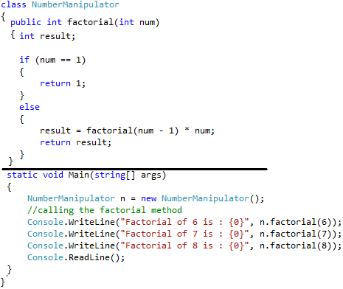
Recursion – with example

Slide 24
Variable Scope
Scope
Global or Static
Local/Automatic
Input Arguments to Methods
Call By Value
Call by reference

Slide 25
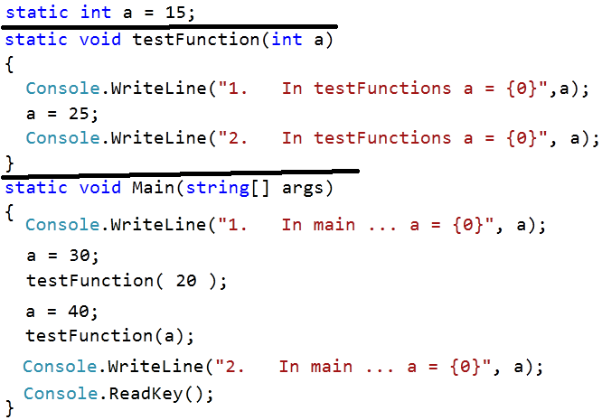
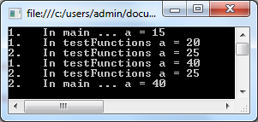
Variable Scope

Slide 26
Variable Scope

Slide 27
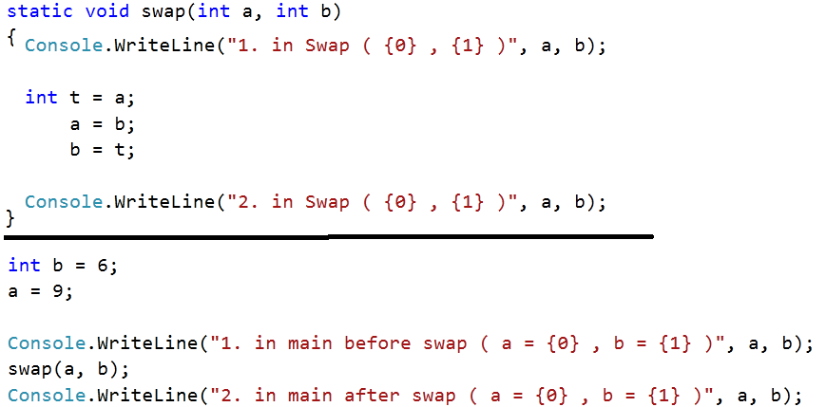
By Value

Slide 28
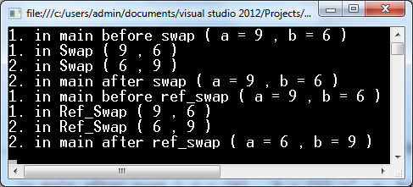
Output with By Value

Slide 29
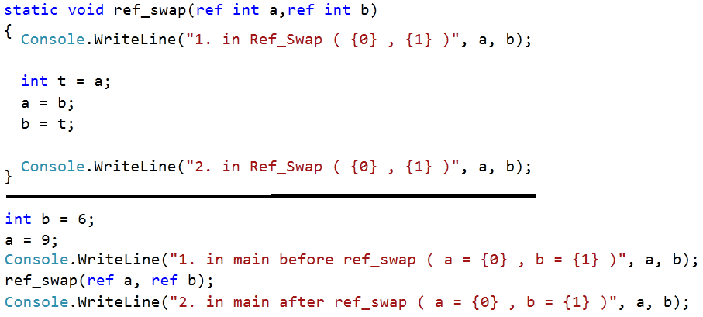
By Reference

Slide 30
Output with By Reference

